Slide 1


NEXT GEN EMPLOYABILITY PROGRAM
CREATING A
FUTURE-READY WORKFORCE
Student Name :
UPENDAR THOTA
College Name :
Student ID:
CHAITANYA DEEMED TO BE UNIVERSITY HANAMKONDA,WARANGAL,TELANGANA,506001.
STU63fe4944b4b941677609284

Slide 2
CAPSTONE PROJECT SHOWCASE
Project Title
Car Rental Application with Django Framework
Abstract | Problem Statement | Project Overview | Proposed Solution | Technology Used | Modeling & Results | Conclusion | Q&A

Slide 3
Abstract
1
It provides a friendly graphical user interface which proves to be better when compared to the existing system.
2
Convenience: The app offers a user-friendly interface that makes booking a rental car quick and easy.
3
Variety: Users can choose from a diverse fleet of vehicles, including sedans, SUVs, and luxury cars.
4
Flexibility : Customers can pick up and drop off their rental cars at various locations, providing maximum convenience.

Slide 4


Problem Statement
Limited Availability: Customers often struggle to find available rental cars, especially during peak travel seasons.
Inconsistent Pricing : Rental rates can vary significantly across different providers, making it difficult to find the best deal.
Poor User Experience : Many existing car rental platforms have complex booking processes and limited customer support.

Slide 5

Project Overview
Streamlined Booking: The web application will offer a user-friendly interface that simplifies the rental process, allowing customers to quickly find and book the perfect car.
Competitive Pricing: By partnering with a wide network of rental providers, the app will ensure customers receive the best rates available.
Exceptional Customer Support: Dedicated customer service representatives will be available to assist users with any questions or concerns throughout their rental experience.

Slide 6
Proposed Solution
Intuitive User Interface: Easy browsing and booking.
Simplified Booking Process: Clear instructions, minimal steps.
Responsive Customer Support: Assistance throughout rental journey.
Two-Factor Authentication: Enhanced account security.
Data Encryption: Protection for sensitive user data.
Comprehensive Database: The app will maintain a robust database of available rental cars, including real-time inventory and pricing information
Seamless Booking Process: The booking process will be streamlined, allowing customers to reserve their rental car with just a few clicks.

Slide 7
Technology used
Backend:
Django framework powers the website's backend, managing user authentication, database, and URL routing.
Frontend:
HTML for structure, CSS for styling, and JavaScript for interactivity.
Frontend Framework:
Bootstrap streamlines design and ensures responsiveness across devices.
Database:
SQLite organizes data related to users, vehicles, and bookings, ideal for development and testing..

Slide 8
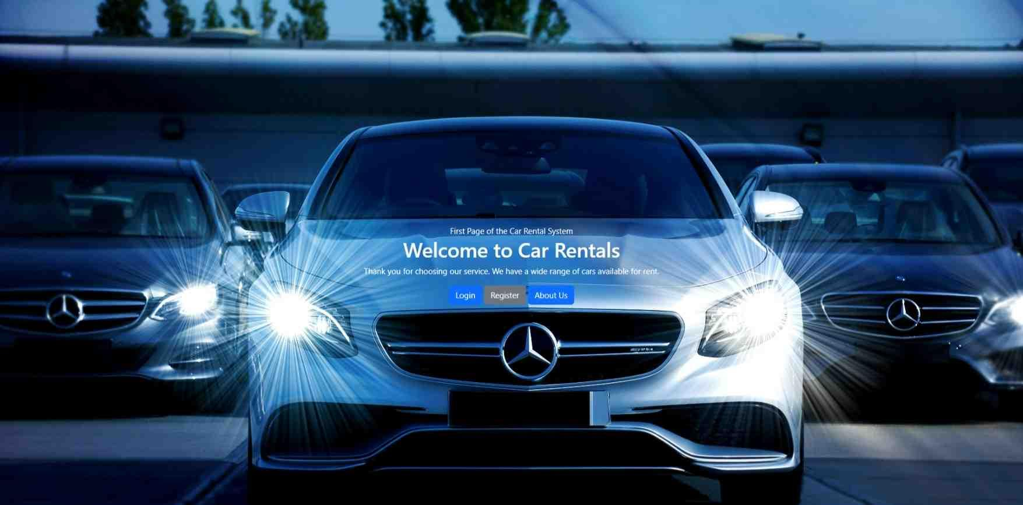
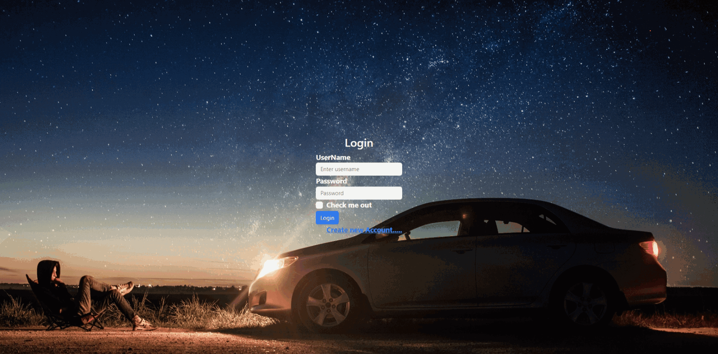
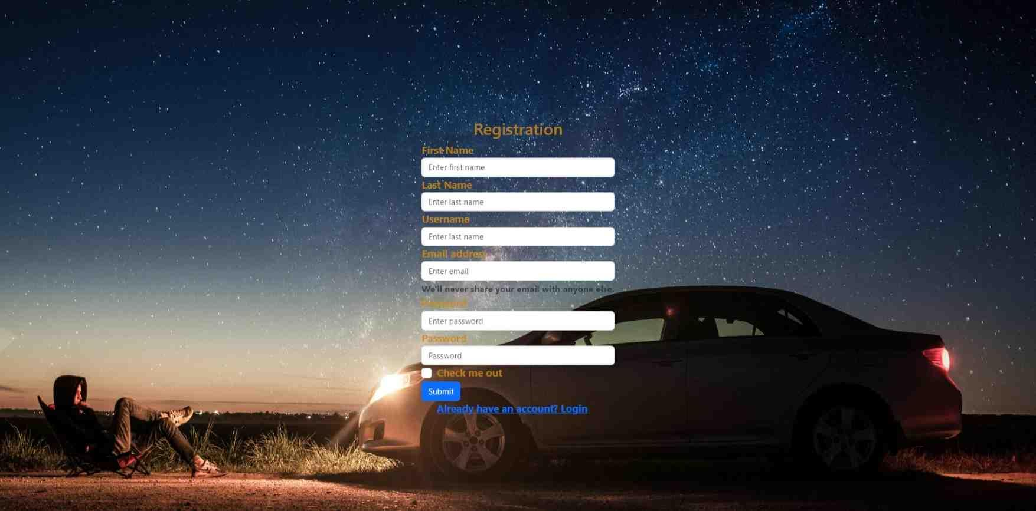
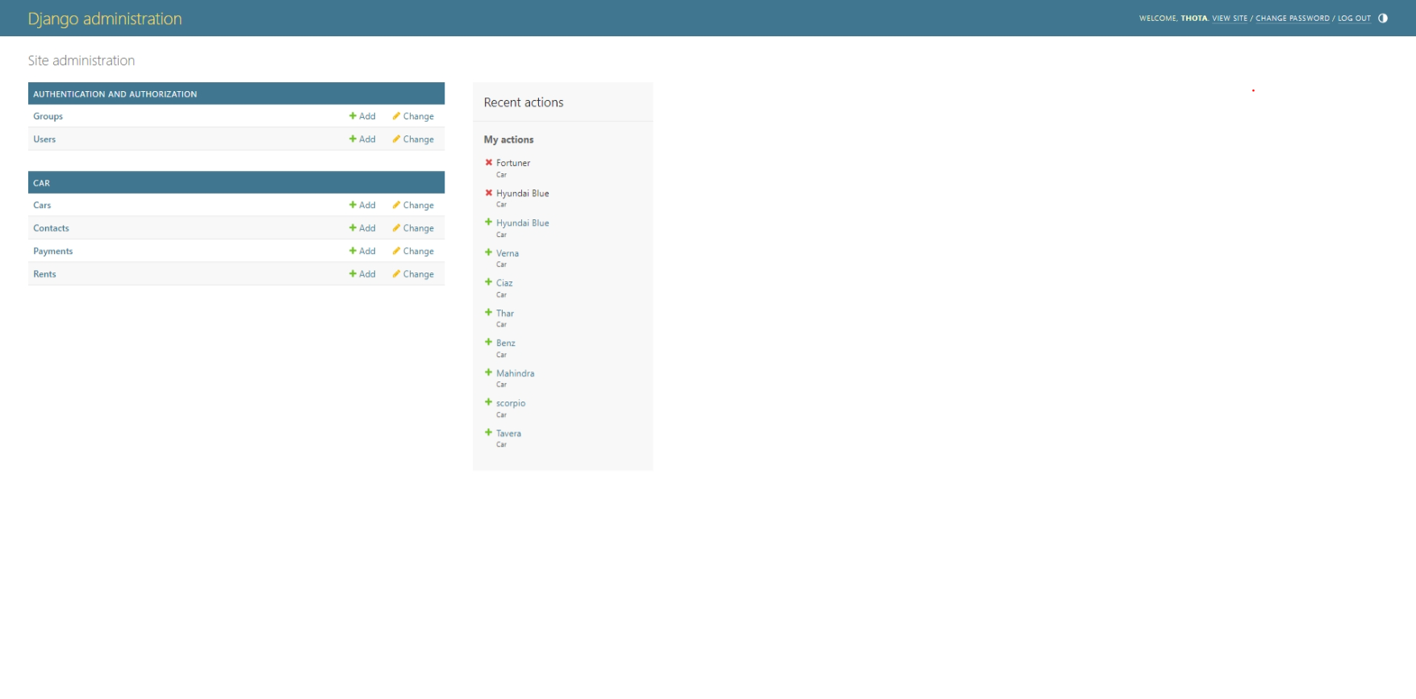
Modelling & Result
Index page
Login Page
Registration Page
Admin Panel

Slide 9
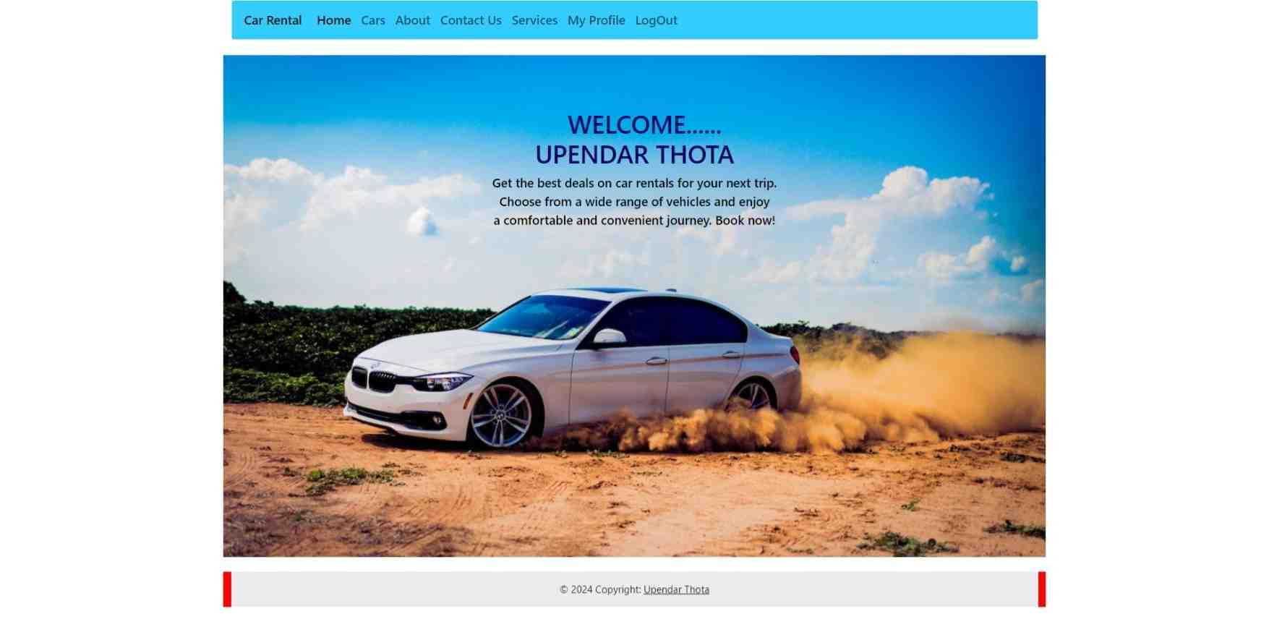
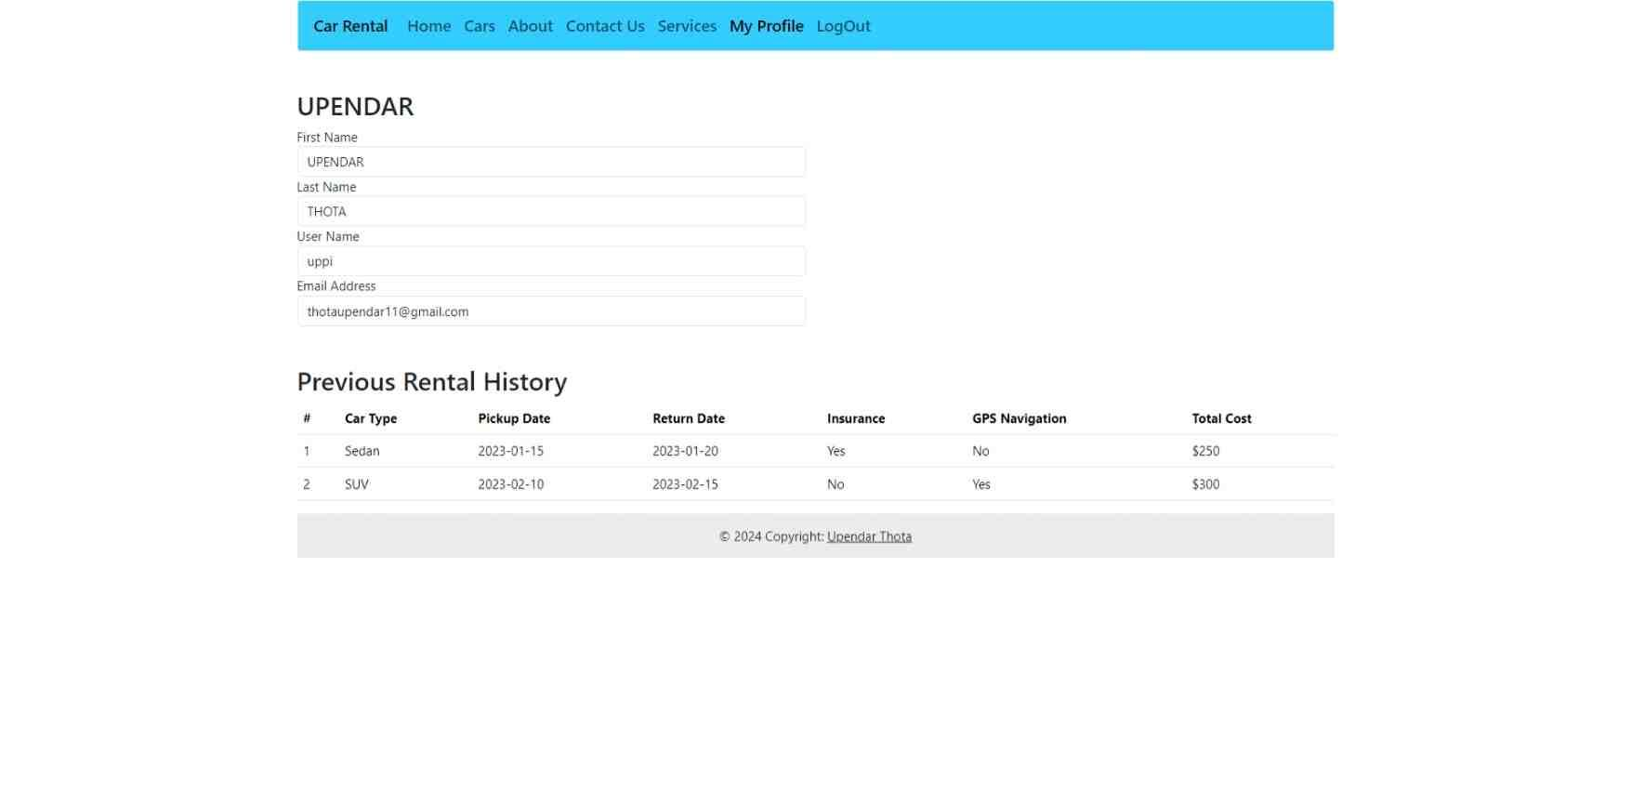
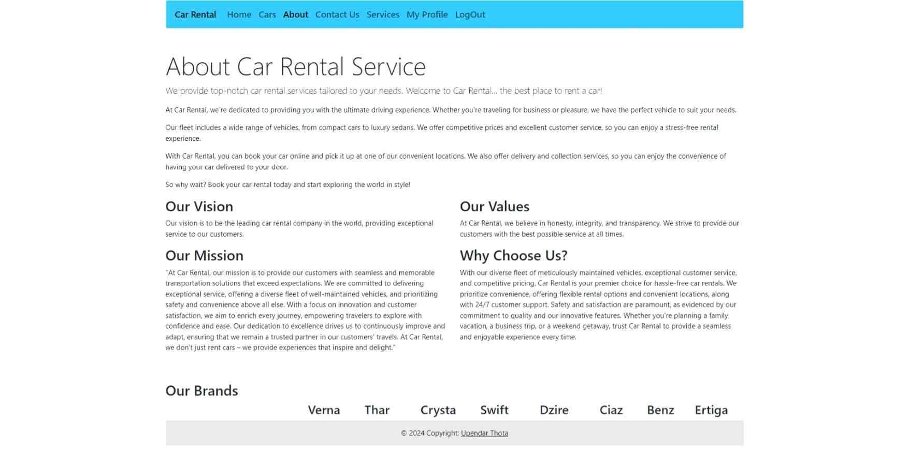
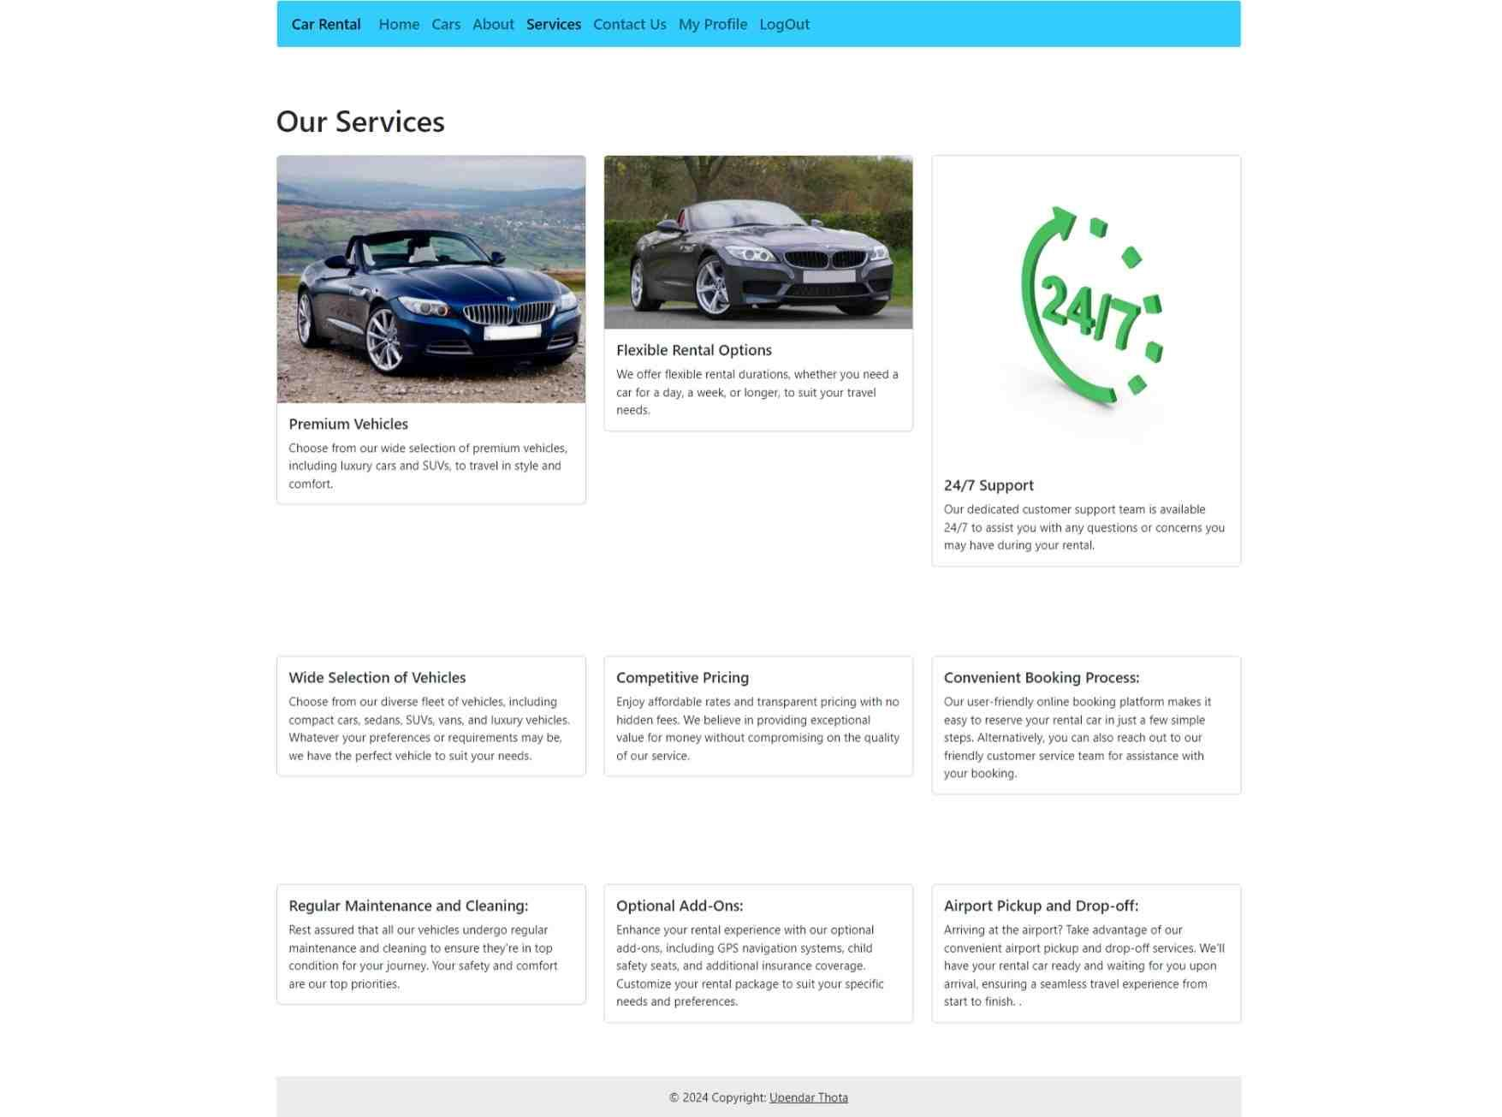
Modelling & Result
Home Page
Profile Page
About Page
Services Page

Slide 10
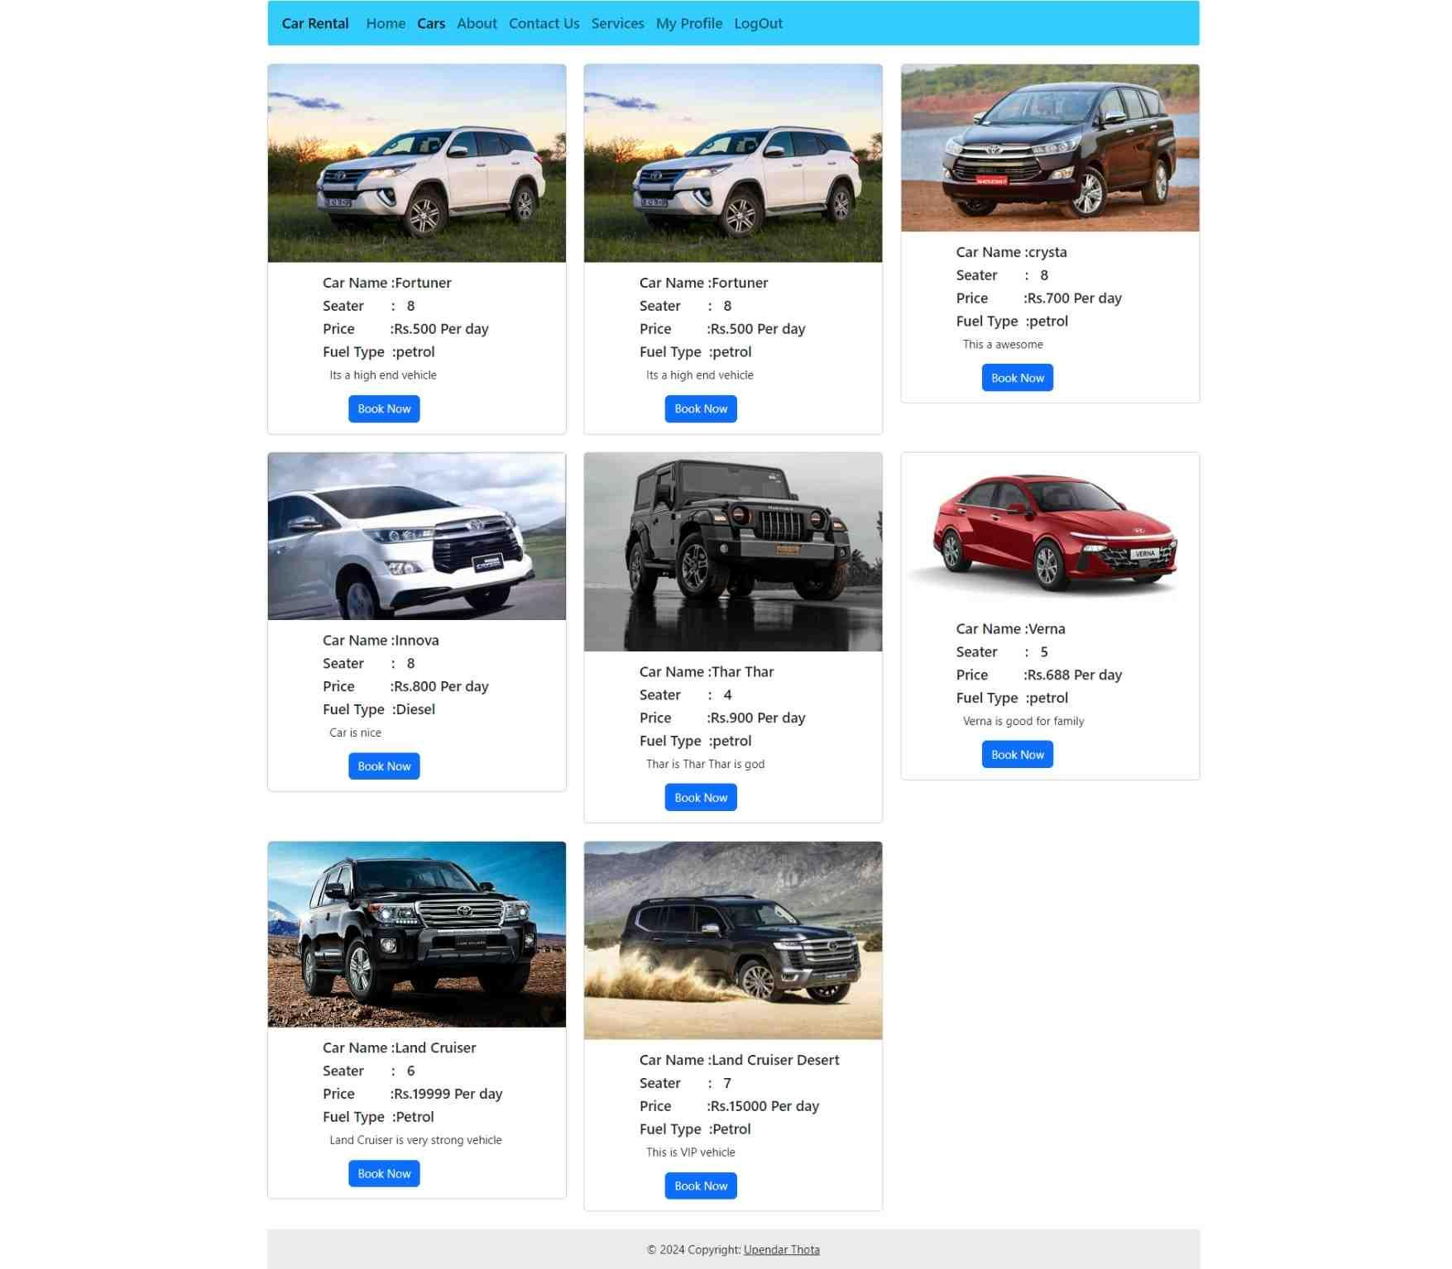
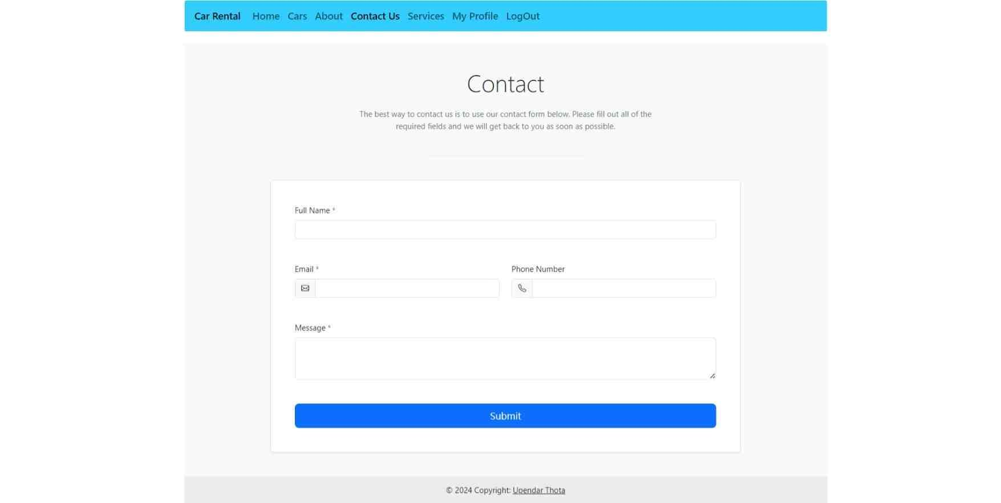
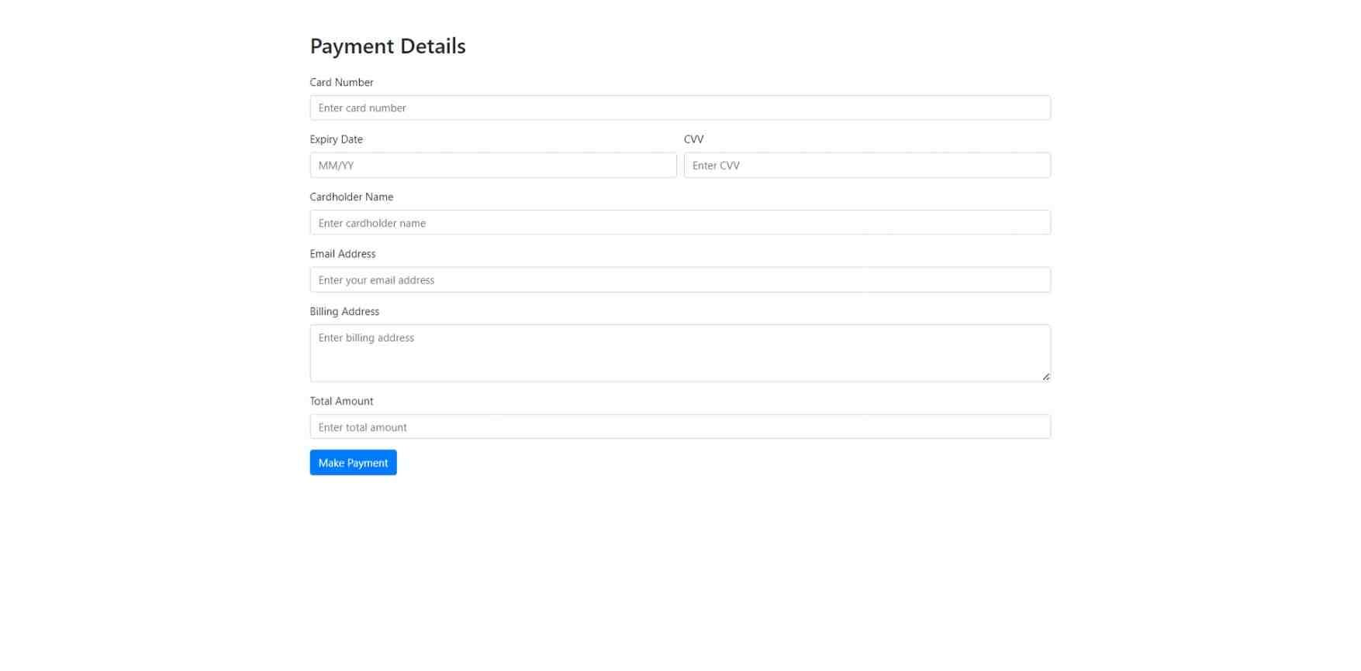
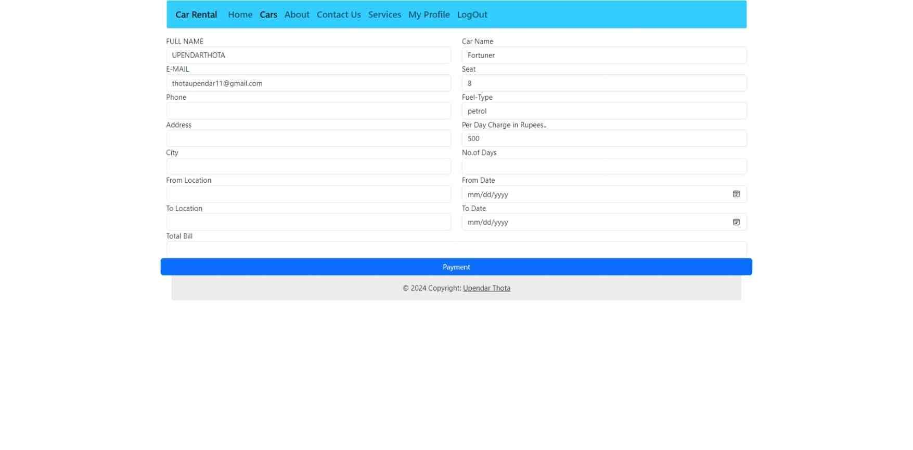
Modelling & Result
Contact Page
Payment Page
Order/Rent Page
Cars Page

Slide 11

Conclusion
Enhanced User Experience:
The car rentals web application will provide customers with a seamless and personalized rental experience.
Scalable Solution :
The platform's modular design will allow for future expansions and adaptations to evolving customer needs.

Slide 12


Notes:
Thank You !!

